Slide 1

Multi-way Voting System
UNDER THE
SUPERVISION OF:
Bhaskar Adepu
Niharika Venishetty 11-1818
Koushik Nallani 11-1852
Koundinya Marka 11-1842
Sheshank Yadav 11-1839
Sai Harsha Kaja 11-1820

Slide 2

Objective
To increase percentage of voting in India.

Slide 3
Project Description
To implement Multi-Way Voting System for General Elections in India.
In Voting System voter can cast his vote in any of the three ways.

Slide 4
Project Description
Multi-way Voting System
Missed Call
IVRS
Online

Slide 5

Missed Call Voting

Slide 6
Missed Call Voting
In Missed Call Voting System we assign a unique Toll-Free number
Voter can give a missed call to one of the Toll-free numbers
Counting process is done automatically on the basis of number of missed calls.

Slide 7
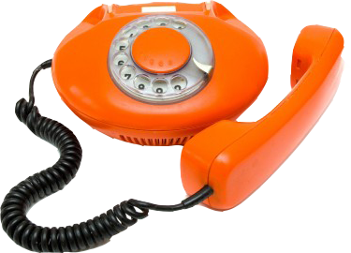
Interactive voice response

Slide 8
Interactive Voice Response System
In IVRS Voting System each constituency will be given a toll-free number.
Voter can listen to the list of contestants through IVR.
Voter can select the respective number to whom he/she wants to vote.

Slide 9
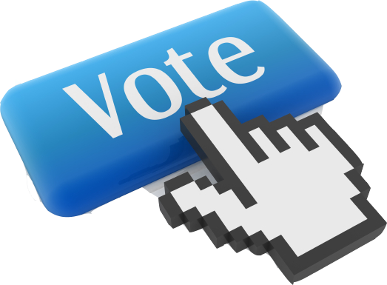
Online Voting System

Slide 10
Online Voting System
In Online Voting Voter login with his voter Id and password.
An e-Ballot will be displayed of his constituency.
The voter can select any one of the contestant to whom the voter is willing to vote.

Slide 11
Traditional Methods
Voting System
Ballot
EVM

Slide 12

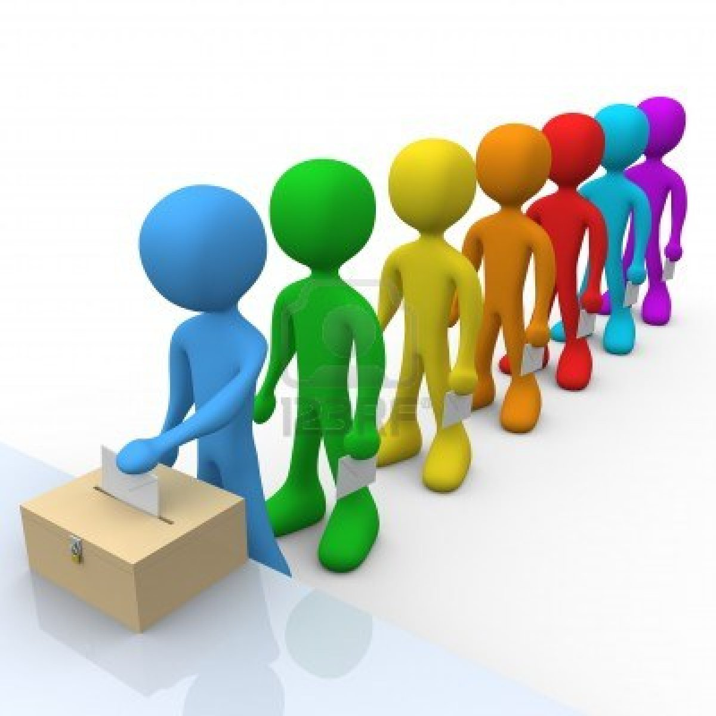
Ballot
It’s a scrap of paper on which the list of candidates is printed.
The elector votes by stamping on contestant symbol.
Ballot is dropped in Ballot box.
Notes:
Ballot paper is a scrap of paper on which the list of candidates is printed
Elector is checked against the elector roll and a ballot paper is allocated to him
The elector votes by marking the ballot paper with a rubber stamp on or near the candidate symbol whom he wants to vote
Then he folds the paper and inserts the ballot paper into the common ballot box

Slide 13
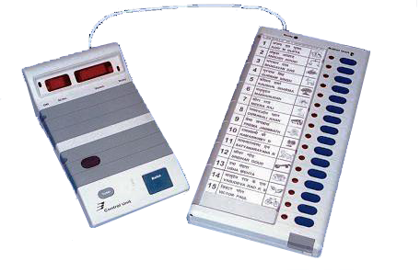
Electronic Voting Machine(EVM)
Electronic Voting Machines ("EVM") are being used since 1999.
The elector votes by clasp the button against contestant symbol.
Disadvantage:
EVMs have been under a cloud of suspicion over their alleged tamper ability and security problems during elections.
An EVM can record a maximum of 3840 votes.
An EVM can cater to a maximum of 64 candidates.
Notes:
Electronic Voting Machines ("EVM") are being used in Indian State and General Elections to implement electronic voting in part from 1999 elections.
The EVMs reduce the time in both casting a vote and declaring the results compared to the old paper ballot system.
Disadvantage
EVMs have been under a cloud of suspicion over their alleged tamparability and security problems during elections
An EVM can record a maximum of 3840 votes
An EVM can cater to a maximum of 64 candidates

Slide 14

Traditional Vs Multi-way Voting
Traditional
Multi-way
Takes time and human resources.
Doesn’t give an instant poll result.
Hard to track who voted and who didn’t.
User convenience.
Gives instant poll result.
Easy to track who voted and who didn’t.
Saves valuable time.
Notes:
Electronic Voting Machines ("EVM") are being used in Indian State and General Elections to implement electronic voting in part from 1999 elections.
The EVMs reduce the time in both casting a vote and declaring the results compared to the old paper ballot system.
Disadvantage
EVMs have been under a cloud of suspicion over their alleged tamparability and security problems during elections
An EVM can record a maximum of 3840 votes
An EVM can cater to a maximum of 64 candidates

Slide 15

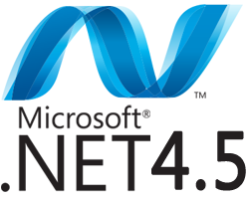


Technology

Slide 16

Pros & Cons
Increment of voting percentage.
Can be implemented with less budget.
Saves the time of voter.
Rigging can be controlled.
Every voter should have a mobile.
Notes:
Pros:
Increment of voting percentage.
Can be implemented with less budget.
Saves the time of voter.
Rigging can be controlled.
Cons:
Every voter should have a mobile.

Slide 17


Slide 18
